Slide 1
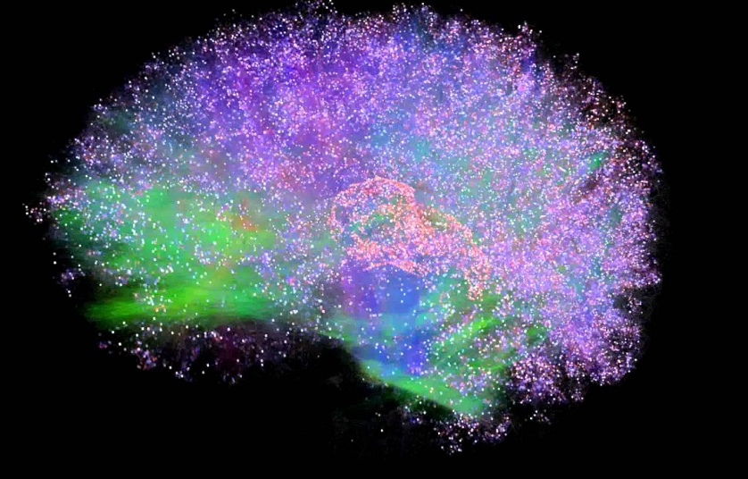
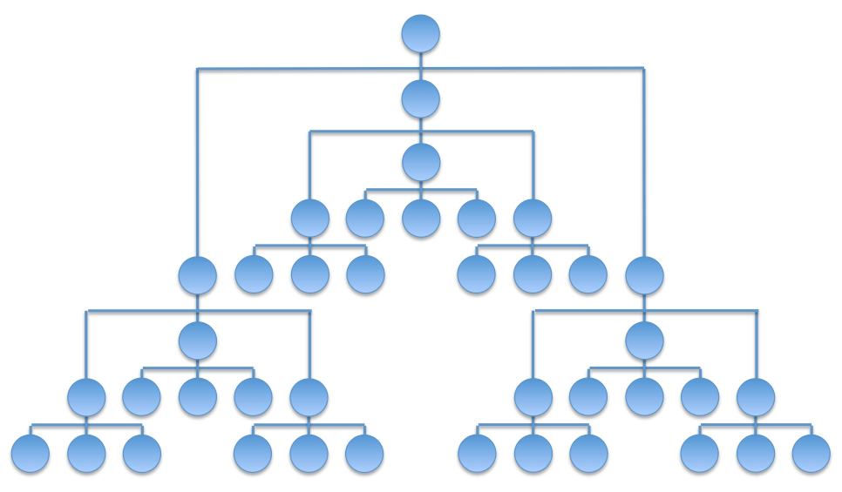
Integrated Information Theory for Organisational Consciousness
Jonathan Peters
Supervisors: Mariano Beguerisse, Christian Bick, Yakov Kremnitzer, Steve Brewis, Steve Cassidy

Slide 2
Mechanisms
Or
And
Xor

Slide 3

Transition Probability Matrix
$$T_{ij}=P(G^{t+1}=j|G^{t}=i)$$
State | 000 | 100 | 010 | 110 | 001 | 101 | 011 | 111
000 | 1 | 0 | 0 | 0 | 0 | 0 | 0 | 0
100 | 0 | 0 | 0 | 0 | 1 | 0 | 0 | 0
010 | 0 | 0 | 0 | 0 | 0 | 1 | 0 | 0
110 | 0 | 1 | 0 | 0 | 0 | 0 | 0 | 0
001 | 0 | 1 | 0 | 0 | 0 | 0 | 0 | 0
101 | 0 | 0 | 0 | 0 | 0 | 0 | 0 | 1
011 | 0 | 0 | 0 | 0 | 0 | 1 | 0 | 0
111 | 0 | 0 | 0 | 1 | 0 | 0 | 0 | 0

Slide 4
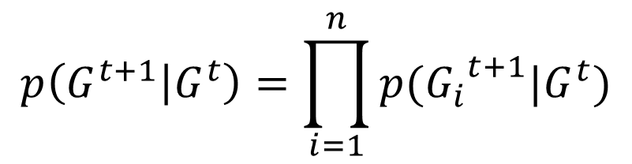

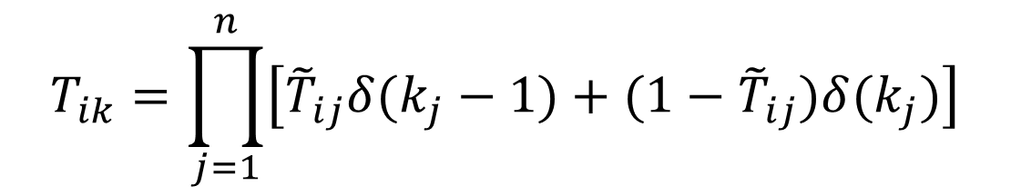
Transition Probability Matrix
$$p\left(G^{t+1} | G^{t}\right)=\prod_{i=1}^{n}{p({G_{i}}^{t+1}|G^{t})}$$
State | A | B | C
000 | 0 | 0 | 0
100 | 0 | 0 | 1
010 | 1 | 0 | 1
110 | 1 | 0 | 0
001 | 1 | 0 | 0
101 | 1 | 1 | 1
011 | 1 | 0 | 1
111 | 1 | 1 | 0
$${\tilde{T}}_{ij}=P({G_{j}}^{t+1}=1|G^{t}=i)$$
$$T_{ik}=\prod_{j=1}^{n}{\left[{\tilde{T}}_{ij}δ(k_{j}−1)+(1−{\tilde{T}}_{ij})δ(k_{j})\right]}$$

Slide 5
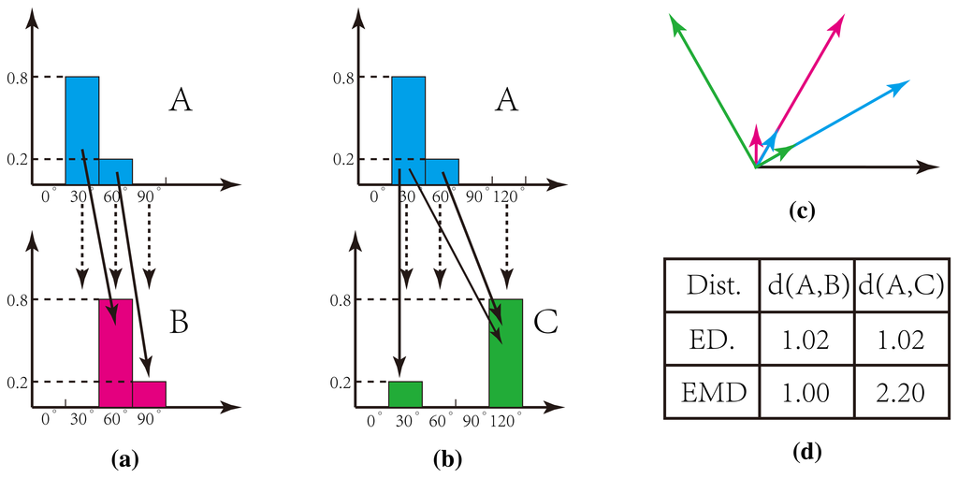
Earth Mover’s Distance

Slide 6
Transition Probability Matrix
$$p\left(G^{t+1} | G^{t}\right)=\prod_{i=1}^{n}{p({G_{i}}^{t+1}|G^{t})}$$
State | A | B | C
000 | 0 | 0 | 0
100 | 0 | 0 | 1
010 | 1 | 0 | 1
110 | 1 | 0 | 0
001 | 1 | 0 | 0
101 | 1 | 1 | 1
011 | 1 | 0 | 1
111 | 1 | 1 | 0
$${\tilde{T}}_{ij}=P({G_{j}}^{t+1}=1|G^{t}=i)$$
$$T_{ik}=\prod_{j=1}^{n}{\left[{\tilde{T}}_{ij}δ(k_{j}−1)+(1−{\tilde{T}}_{ij})δ(k_{j})\right]}$$

